Slide 1
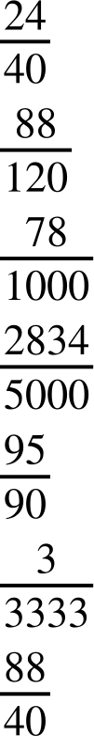
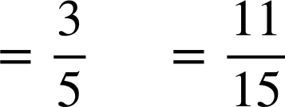
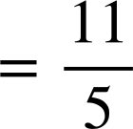
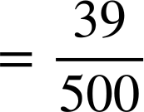
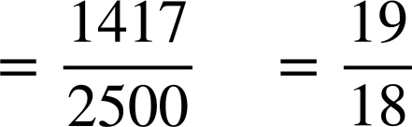
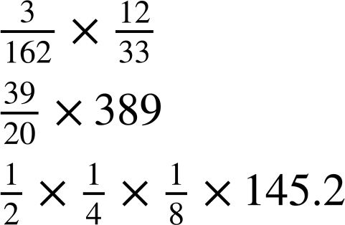
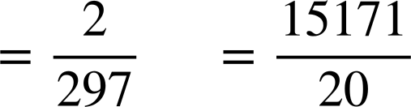
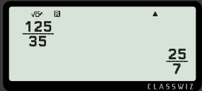
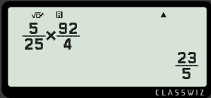
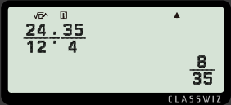
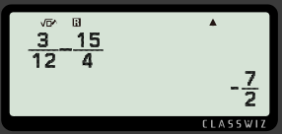
Converting fractions with technology
Task A: Using a calculator to simplify fractions
1) Using your calculator, write the simplified fractions to:
a)
b)
c)
d)
e)
f)
2) Using a calculator, work out the answers to the following giving your answer as a proper or improper fraction.
a)
b)
3) Figure out the missing digits on the calculator screen to make the calculation correct.
a)
b)
c)
d)

Slide 2

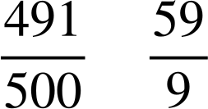

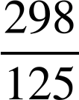



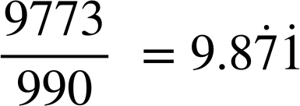
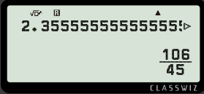
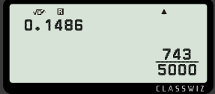
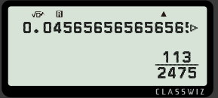
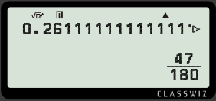
Converting fractions with technology
Task B: Convert between fractions and decimals
1) Using your calculator, fill in the table below.
Decimal | Simplified fraction
2) Find the missing values on the calculator displays.
a)
b)
c)
d)

Slide 3
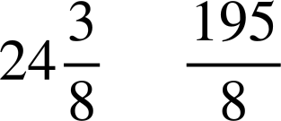
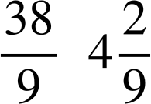
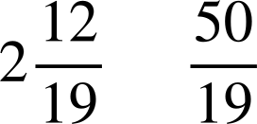
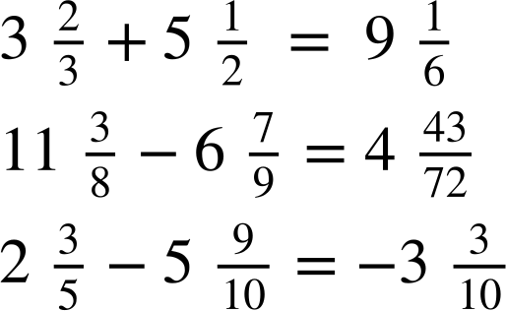
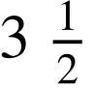
Converting fractions with technology
Task C: Mixed numbers on a calculator
1) Fill in the table below.
Mixed number | Improper fraction | Decimal
24.375
4.2222222…
2.631578947
2) Work out the following calculations using your calculator. Give your answer as a mixed number.
a)
b)
c)
d) Create your own calculations where the answer is
Mathematics in Education and Industry
v2.2

